Slide 1
COST OF LIVING
ANALYSIS
by Neha Prasad

Slide 2
Project Abstract
This project revolves around the analysis of the cost of living in various cities and countries across the
globe. The dataset used for this analysis encompasses a wide range of economic indicators, from the
price of basic commodities to the cost of housing, transportation, and even entertainment.
By harnessing the power of Power BI, we aim to gain valuable insights into the economic disparities
between different regions and understand the factors that contribute to the varying costs of living. This
project serves as an exercise in data visualization, analysis, and interpretation, offering a comprehensive
view of the world's economic landscape.

Slide 3
Problem Statement
The cost of living is a crucial metric that impacts individuals and businesses alike. Understanding the cost of living in different cities and countries is vital for making informed decisions regarding relocation, investment, or business expansion.
This project aims to address several key questions:
• What are the cities and countries with the highest and lowest costs of living?
• What are the major cost components contributing to the overall cost of living in a region?
• How do factors like average salary, housing costs, and transportation expenses correlate with the cost of living?
• Are there any trends or patterns in the data that can help individuals and organizations make strategic decisions?

Slide 4
Dataset Information
The dataset utilized in this project is sourced from Numbeo, a collaborative online database that provides cost of living information worldwide.
It contains 56 columns, including information about cities, countries, and a wide array of cost-related variables, ranging from grocery prices to real estate costs.
The dataset consists of the following variables:
City: Name of the city.
Country: Name of the country.
x1 – x55: cost-related variables.
data_quality: A binary variable (0 or 1) indicating data quality.

Slide 5
INSIGHTS
Created a Dashboard, followed by a Basic Commodity Report and an Entertainment & Services Report to provide meaningful conclusions

Slide 6
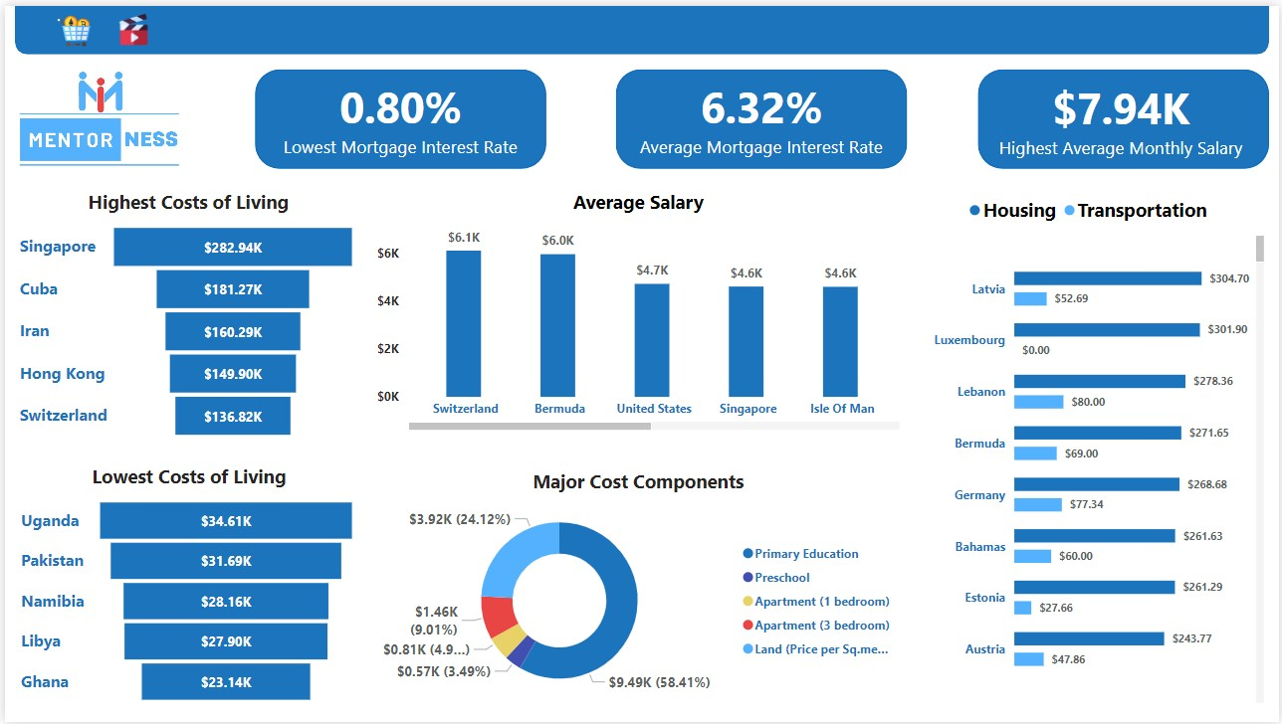
Dashboard

Slide 7
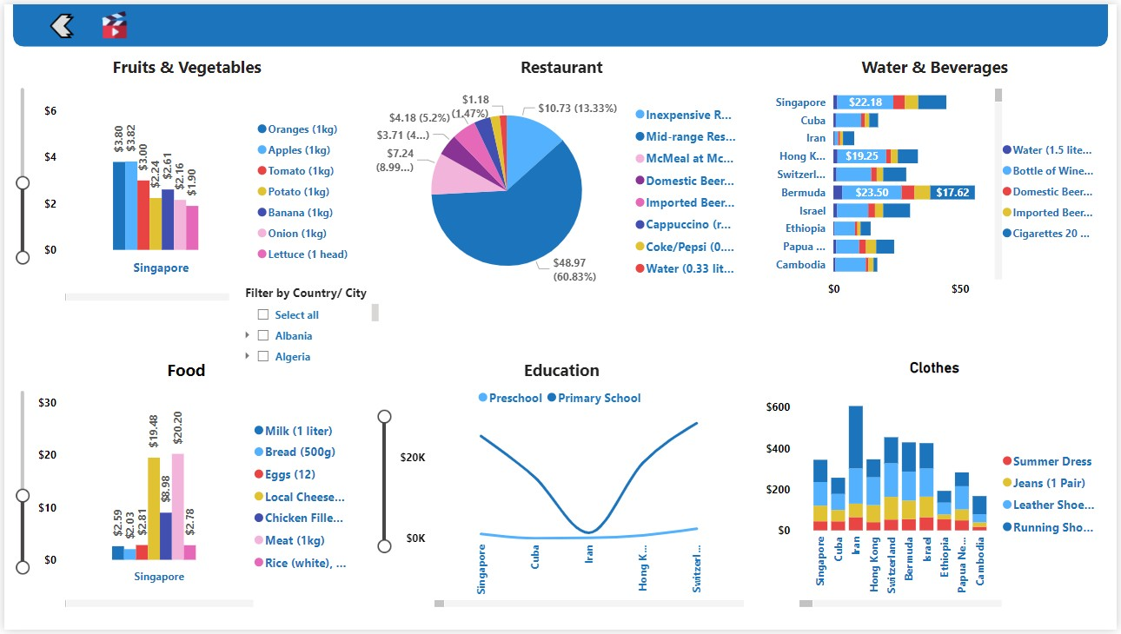
Basic Commodity Report

Slide 8
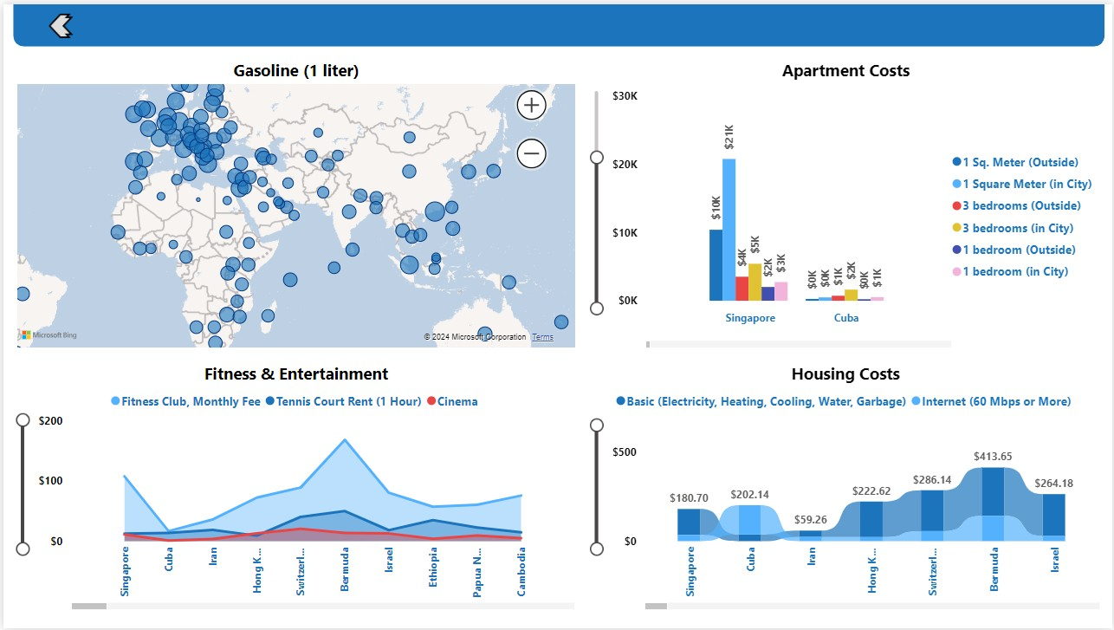
Entertainment & Services Report

Slide 9
THANK YOU

